Slide 2
VERBAL TESTS types and purpose

Slide 3
CLASSIFICATION OF TESTS
test
ability
aptitude
intelligence
personality
Adjustment
Attitude
Character
interest
VERBAL
Non-Verbal
achievement
HIERARCHY

Slide 4
To understand verbal test first of all we should know about non-verbal tests
Non-verbal tests: in non-verbal intelligence tests the items are expressed by material, i.e. pictures, diagrams, line drawing, pattern etc. Reading and writing are not required. but these tests make extensive use of pictures, diagrams, objects to measure intelligence, reasoning and other skills .

Slide 5
FOR EXAMPLE:-
Choose the figure which is different from the rest.
(1) (2) (3) (4) (5)

Slide 6
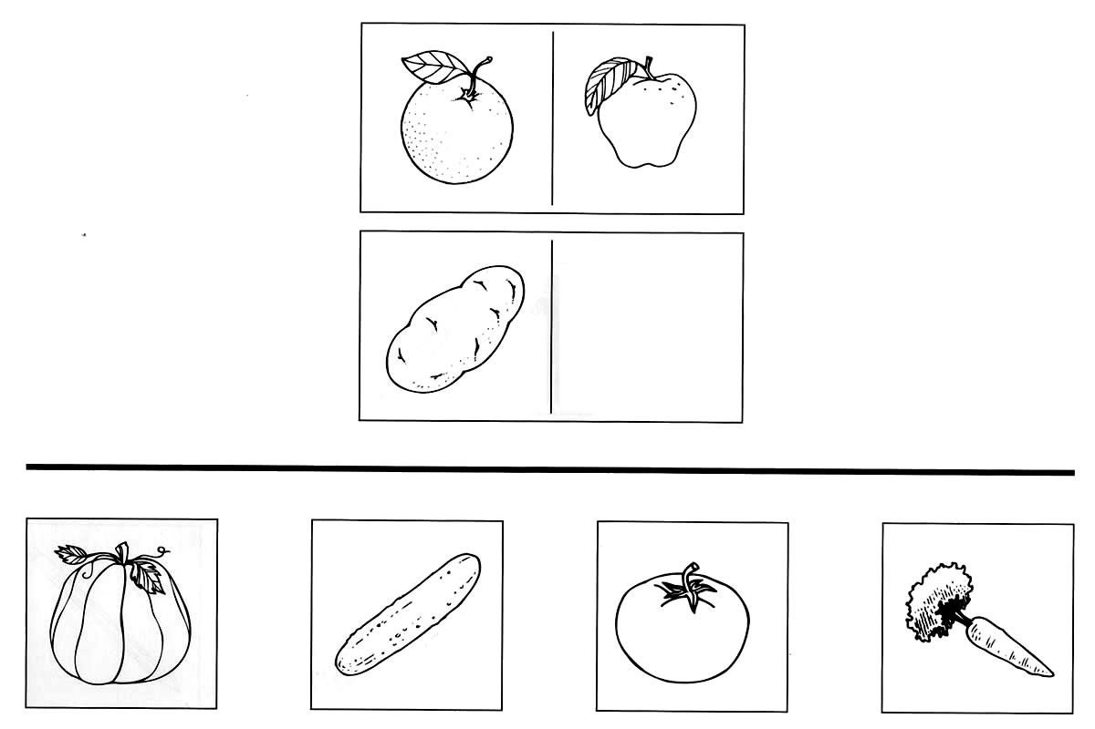
EXAMPLE

Slide 7
Verbal test
In verbal intelligence test the items are expressed in language form. The form of language may be reading, writing or oral communication.
Most 0f the school tests are verbal because school stress verbal ability.

Slide 8
Examples of verbal test
class tests, mid term, final term, annual examinations.
Competitive exams e.g. CSS, PMS.
Screening test.
Admission/entry tests.

Slide 9
What is the difference between verbal and non-verbal test ????

Slide 10
Difference between verbal and non verbal tests
Verbal tests
Non-verbal tests
verbal tests require the use of language to answer the test items. Reading and writing are required.
These tests do not require the use of language to respond to the test items.
Reading and writing are not required. There are extensive use of pictures, diagrams, objects etc.

Slide 11
Types of verbal tests
Analogy test
Jumbled words/sentences
General knowledge test
Coding and decoding test
Multiple choice questions (MCQs)
Synonyms /antonyms

Slide 12
Purposes of verbal tests
Admission of students to school/college.
Evaluate the power of reading, writing, comprehension, critical thinking, analysis and synthesis.
Classification of students.
Selection of students to different courses.

Slide 13
5. Detection of inferior and superior intelligence.
6. Award of scholarship/promotion/ grading.
7. VERBAL TESTS provide us reliable, stable, and valid type of evaluation.

Slide 14
ANY QUESTION ???

